Slide 1

Quickly Hacking Apps on Azure with Serverless
AI Hackathon Workshop
Will Eastbury
Campus London, 23rd June 2017

Slide 2
What do we have to help you quickly build AI applications at scale ?
Notes:
This is what most of our customers and ISVs do, dip their toe in the water with IaaS first as it’s perceived to be a quick win.
Let’s take a closer look and see just how quick a win this can be !

Slide 3
Edge DC
IaaS
PaaS
SaaS
Application
Application
Application
Application
Data
Data
Data
Data
Middleware
Middleware
Middleware
Middleware
Operating System
Operating System
Operating System
Operating System
Virtualisation
Virtualisation
Virtualisation
Virtualisation
Storage
Storage
Storage
Storage
Hardware
Hardware
Hardware
Hardware
Networking
Networking
Networking
Networking
Power
Power
Power
Power
Spin up Agility + Operational Efficiency
Legacy Support + Flexibility
Notes:
The classic slide, Build your own DC, vs IaaS vs PaaS vs SaaS, as a consumer of services this view of the world is fine. BUT… this is a hack, let’s talk about what YOU can use, and that you can use quickly.

Slide 4
PaaS
BI/Data aaS
AI+ML aaS
SaaS
Web Apps (+ WebJobs)
Power BI Premium
Batch AI Training
Microsoft Flow
API Apps
Data Lake Store / Analytics
ML Studio
Office 365
SQL Database
Analysis Services
Cognitive Services
Power BI Pro
CosmosDB
HDInsight
Bot Service
Visual Studio TS
Functions
Data Factory
Cortana
Microsoft Teams
Logic Apps
Stream Analytics
Skype
Storage (Blob, Q, Table)
IOT Suite
Azure Batch
IOT Suite
Notes:
Firstly lets remove the stuff we don’t need to deal with to make some more room on the slide.
But when you are selling these services (either a Cloud Service Provider, Or software vendor), it becomes rather more complex, and there is more in play here.

Slide 5
Key Services in Azure PaaS
Front
Citrix XenApp Essentials
Azure App Service
Web, API Apps, Logic Apps, Functions,
Azure API Management
Azure Application Insights
Azure Functions
Middle
Azure Service Bus
Azure Storage
(Blob,
Queue,
Table)
Azure Event Hubs
Azure Log Analytics
Persist
Azure
SQL Database
+PostgreSQL
+MySQL
Azure CosmosDB
Partner Services SendGrid / Twilio
Power BI Premium

Slide 6
Serverless in Azure
Just bring your code…
Just write your code…
{World}

Slide 7
Key aspects of ‘Serverless’ technologies.
Long Term
Deploy code that just runs, no servers (or containers) to patch, manage or maintain.
Hack
Just get started and make stuff work, you can build and deploy services instantly.

Slide 8
The technical case for Serverless

Slide 9
Why would a Developer want to use serverless ?
Ultimate DevOps
Deploy your code package to a single location, deploy it once and see it scale out massively.
Ultimate Encapsulation and Testability
The logical end game when building applications on serverless is highly isolated nano (or) pico-services collected together into a logical API, whether that is RESTful or RPC/https or Service Bus/Queue based.
Ultimate Simplicity
Nothing to manage, the server architecture is all provided for you and scaled and managed on your behalf. You focus on the code and bindings and only the code and bindings.

Slide 10
Why would an IT Pro want to use serverless ?
Predictable and variable cost
My budget will stretch further and I can chargeback based on usage.
Hugely simplified management and ops landscape
No network / patch management on the servers, as there are no servers.
It’s awesome for running operations and management + monitoring services too.
Now we can run monitoring and clean-up batch scripts and console apps without need ing a permanently available server to run them on, what’s not to like?

Slide 11
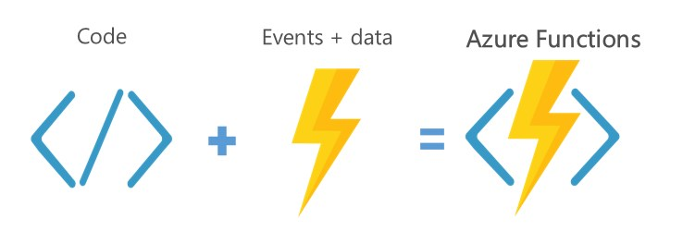
Azure Functions

Slide 12
Why Azure Functions ?
  Charging model can be serverless OR PaaS
    Consumption Plan = Serverless
      (includes a monthly free grant of 1 million requests and 400,000 GB-s of resource consumption per month, after that it’s charged at Execution Time * ~£0.000012/GB-s (1.2 ten thousandths of a penny for a gigabyte of RAM used for 1 second) + Total Executions * ~£0.15 per Million invocations)(*)
    App Service Plan = PaaS, charged for dedicated server instances
  Event Driven or timed execution model
      http request driven = Web API
      Storage Queue / Service Bus driven = Queue Based Load Leveling pattern + Competing consumers
      Timed execution driven = Simple polling / batch processing
      (*) E&OE - Pricing can vary based on time and region
Notes:
Serverless or PaaS platform, you choose
Event driven, or timed execution
Supports bindings for Timers, Event Hubs, queues, webhooks, http requests, Service bus, etc. etc. etc.
Blob Store, table store, SQL, mobile services, etc bindings.
Twilio SMS, Bot Framework, SendGrid.
Supports multiple languages, including
C#
JavaScript
CMD Batch
PowerShell
Python
Etc..
Consumption plan pricing includes a monthly free grant of 1 million requests and 400,000 GB-s of resource consumption per month.
After that
Execution Time * £0.000012/GB-s (1.2 ten thousandths of a penny for a gigabyte of RAM used for 1 second)
Total Executions * £0.15 per Million invocations

Slide 13
Why Azure Functions ?
Wide reaching language support
  C#, F#, Python, JavaScript (Node.js), bash, CMD Batch, PowerShell, Custom EXE
Large number of bindings supported
  Timers, Event Hubs, queues, webhooks, https requests, Service bus, Blob Store, table store, SQL, mobile services, Twilio SMS, Bot Framework, SendGrid etc. etc. etc. etc.
Simple, proven deployment models
  Under the covers this is Azure App Service
  Use Web deploy to deploy a package of functions
  Use FTP deploy to simply copy your function code up
Notes:
Serverless or PaaS platform, you choose
Event driven, or timed execution
Supports bindings for Timers, Event Hubs, queues, webhooks, http requests, Service bus, etc. etc. etc.
Blob Store, table store, SQL, mobile services, etc bindings.
Twilio SMS, Bot Framework, SendGrid.
Supports multiple languages, including
C#
JavaScript
CMD Batch
PowerShell
Python
Etc..
Consumption plan pricing includes a monthly free grant of 1 million requests and 400,000 GB-s of resource consumption per month.
After that
Execution Time * £0.000012/GB-s (1.2 ten thousandths of a penny for a gigabyte of RAM used for 1 second)
Total Executions * £0.15 per Million invocations

Slide 14
Azure Functions architecture
Built on top of App Service and WebJobs SDK
Code
Config
Language Runtime
C#, Node.js, F#, PHP, PowerShell, CMD etc.
Azure Functions
WebJobs Script Runtime
Azure Functions Host – Dynamic Compilation, Language abstractions, etc.
WebJobs Core
Programming model, common abstractions
WebJobs Extensions
Triggers, input and output bindings
App Service Dynamic Runtime
Hosting, CI, Deployment Slots, Remote Debugging, etc.

Slide 15
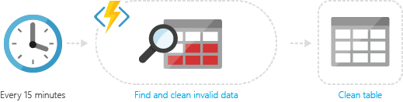
Common Scenarios for Functions
Timer-based processing
  Azure Functions supports an event based on a timer using CRON job syntax
  For example, you could execute code that runs every 15 minutes and cleans up a database table based on custom business logic

Slide 16
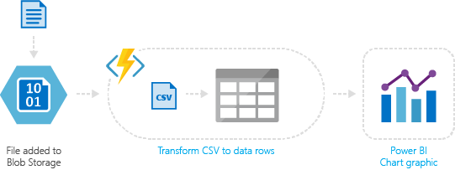
Common Scenarios for Functions
Azure service event processing
  Azure Functions supports triggering an event based on an activity in an Azure service
  For example, you could execute serverless code that reads newly discovered test log files in an Azure Blob Storage container and transforms this into a row in an Azure SQL Database table

Slide 17
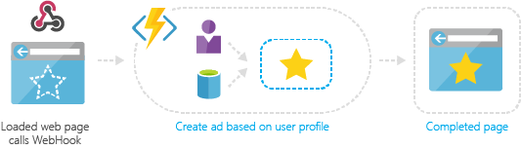
Common Scenarios for Functions
Serverless web application architectures
  Azure Functions can power a single page app
  The app calls functions using the WebHook URL, saving user data and deciding what data to display
  Or, you can do simple customisations, such as changing ad targeting by calling a function and passing it user profile information

Slide 18
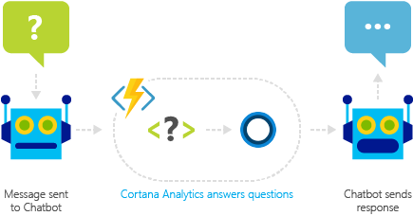
Common Scenarios for Functions
Real-time bot messaging
  Azure Functions can be used to customise the behaviour of a bot using a WebHook
  For example, you can create an Azure Function that processes a message using Cortana Analytics and call this function using Bot Framework

Slide 19
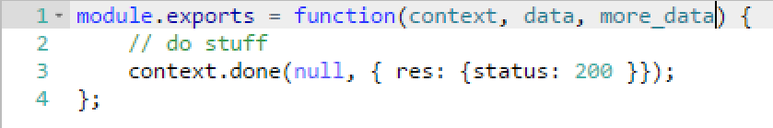
Functions programming concepts (Node.js)
Trigger
Input Bindings
Code
Output Bindings

Slide 20
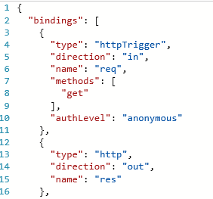
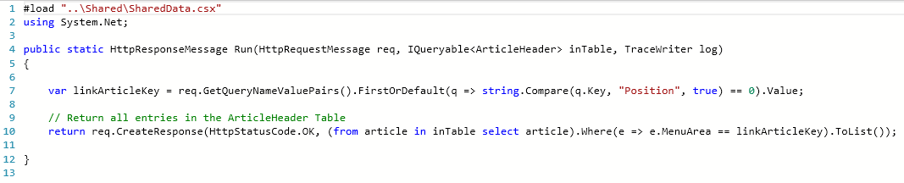
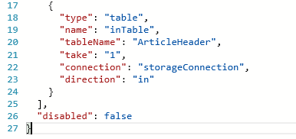
Functions programming concepts (C#)
Trigger
Input(s)
Output
Code

Slide 21
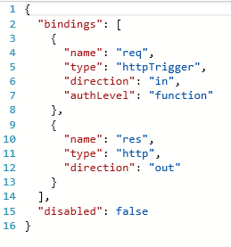

Functions programming concepts (PowerShell)
Input
Trigger
Code
Output

Slide 22
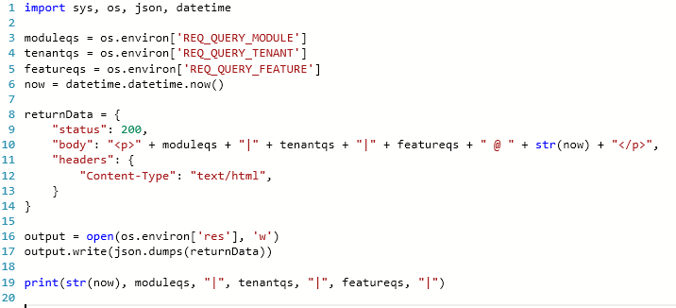
Functions programming concepts (Python)
Input
Trigger
Code
Output

Slide 23
Best practices for the Functions programming model
Functions should “do one thing”
Functions should be idempotent
Functions should finish as quickly as possible
1

Slide 24
Azure Serverless != Just Functions
{World}
{Serverless Storage}

Slide 25
Lots of Azure services can be considered ‘serverless’
Azure Functions (of course!)
Azure Logic Apps
Azure Storage
Azure CDN
Azure Service Bus
Azure Event Hubs
Azure Redis Cache
Cognitive Services
+ Many, many more
Notes:
It is possible to build sites and apps that run only on these services, to leverage consumption based pricing and build high-performance sites and apps that scale linearly and predictably, with costs that scale linearly and predictably.

Slide 26
And some Serverless and PaaS can be run as SaaS
Azure Logic Apps > Microsoft Flow
Power BI Premium > Power BI Pro
Notes:
It is possible to build sites and apps that run only on these services, to leverage consumption based pricing and build high-performance sites and apps that scale linearly and predictably, with costs that scale linearly and predictably.

Slide 27
So, Lets take a look at a simple Azure AI architecture that is quick to hack out.
HTML Single Page App (Single Blob on blob storage)
Function App
Azure Queue Storage
Azure Blob Storage
Cognitive Services Face API
https://aka.ms/blobapp
https://github.com/dxuk/ukofficehours
Notes:
So let’s create the resources we need
A resource group to ‘bucket all of our resources’
A cognitive account for the Face API
A function app to host our backend#
A RM General Purpose Storage Account
Create the resources manually, OR create them as an ARM Template

Slide 28
So, Lets look deeper into what this code will do
JS SPA:
Take in a URI and directly POST it at a Serverless Function (Pico-Service)
Render the Image in the URI
Poll a returned URI every second for the service response
Serverless Pico-Service #1:
Accept the http request, writing the http content to a Queue and responding with ‘202 Accepted’ status, returning a URI to query for the resulting data.
Serverless Pico-Service #2:
Fetch the messages from the queue and call the Cognitive Services Face API for each URI passed in, once processing is complete – write the resulting output to the query URI passed by Service #1.
https://aka.ms/blobapp
https://github.com/dxuk/ukofficehours
Notes:
This *really* is a single page application, no bundling needed here ☺
If you need a more sophisticated deployment and ServerSide code (e.g. ASP.NET Core, Java / Tomcat etc), look to Azure App Service.
Describe the async nature of the call to the pico service #1 and how the service is polling the result of pico Service#2 ‘s invocation.
Explaim that I will implement and show Serverless PicoService #1
Explain that Gabriel will show PicoService #2
And if this is still too complex to get up and running, you can see a sample telemetry app (which is invoked synchronously @ http://aka.ms/blobapp
Now create the 2 picoservices in the function app
ImageProc (http binding)
FaceQueueProcessor (Queue Binding)
Creating the Connection to the Storage Account as we go

Slide 29
So, lets show this working @ https://aka.ms/serverlessdemo
https://aka.ms/aiapp
https://aka.ms/blobapp
https://github.com/dxuk/ukofficehours
Notes:
Backup plan is here
https://journeyfunctionstorage.blob.core.windows.net/spa/default_ai.html
Diego Costa http://img-s-msn-com.akamaized.net/tenant/amp/entityid/BBD0Lyr.img?h=764&w=1019&m=6&q=60&o=f&l=f&x=565&y=222
ME! https://media.licdn.com/mpr/mpr/shrinknp_200_200/AAEAAQAAAAAAAAjnAAAAJDg5YjBmNmYzLWJlNmUtNDdhOS1hZTFiLTU1YzNiNjJlYmRmZg.jpg

Slide 30
So, lets show you how to build it.
https://aka.ms/serverlessdemo
https://aka.ms/blobapp
https://github.com/dxuk/ukofficehours
Notes:
Backup plan is here
https://journeyfunctionstorage.blob.core.windows.net/spa/default_ai.html
Diego Costa Image
http://img-s-msn-com.akamaized.net/tenant/amp/entityid/BBD0Lyr.img?h=764&w=1019&m=6&q=60&o=f&l=f&x=565&y=222

Slide 31
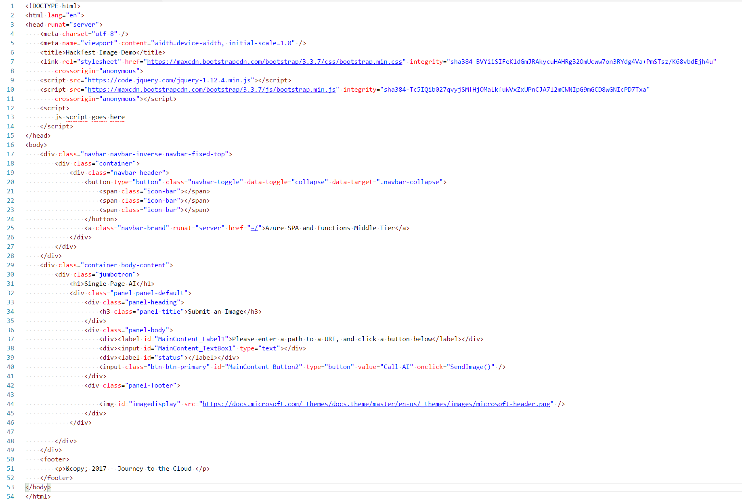
The
SPA html

Slide 32
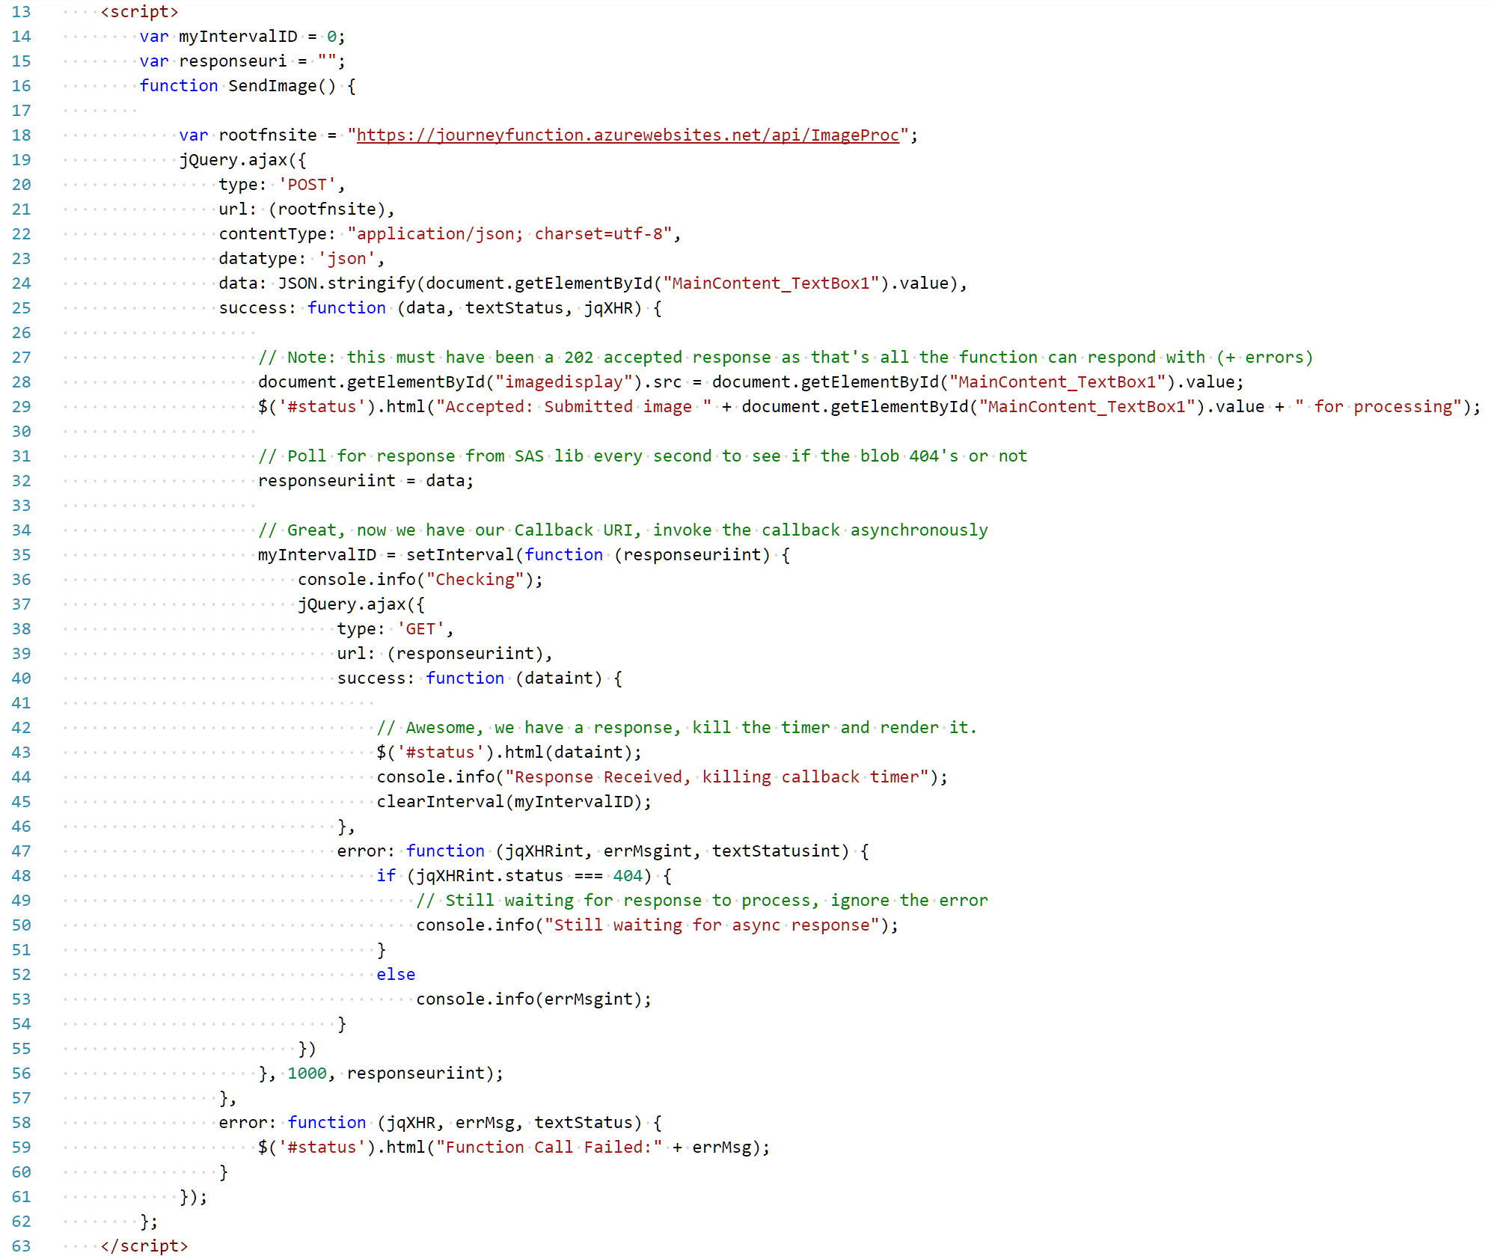
The
SPA js
Notes:
1. Change the Script code to point to the root of the new functionapp
(change root of URI on line 18 of default_ai.html)
2. On the storage account create a single PUBLIC container called demoai
3. Create a private container called images
4. Upload the source for the html to a blob in /demoai/default_ai.html

Slide 33
The Pico-Service
#1
Bindings
{
  "bindings": [
    {
      "authLevel": "anonymous",
      "name": "req",
      "type": "httpTrigger",
      "direction": "in"
    },
    {
      "name": "$return",
      "type": "http",
      "direction": "out"
    },
    {
      "type": "queue",
      "name": "outQ",
      "queueName": "imagequeue",
      "connection": "journeyfunctionstorage_STORAGE",
      "direction": "out"
    }
  ],
  "disabled": false
}
Notes:
Map the correct string name into the connection for storage
{
"bindings": [
{
"authLevel": "anonymous",
"name": "req",
"type": "httpTrigger",
"direction": "in"
},
{
"name": "$return",
"type": "http",
"direction": "out"
},
{
"type": "queue",
"name": "outQ",
"queueName": "imagequeue",
"connection": "journeyfunctionstorage_STORAGE",
"direction": "out"
}
],
"disabled": false
}

Slide 34
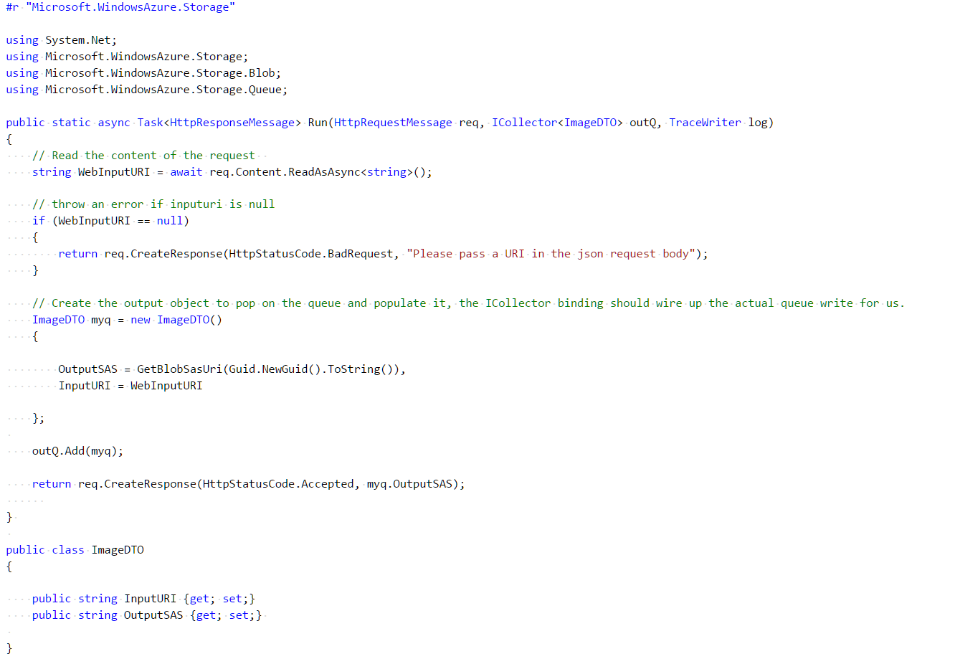
The Pico-Service
#1
C# Code
(Pt 1)

Slide 35
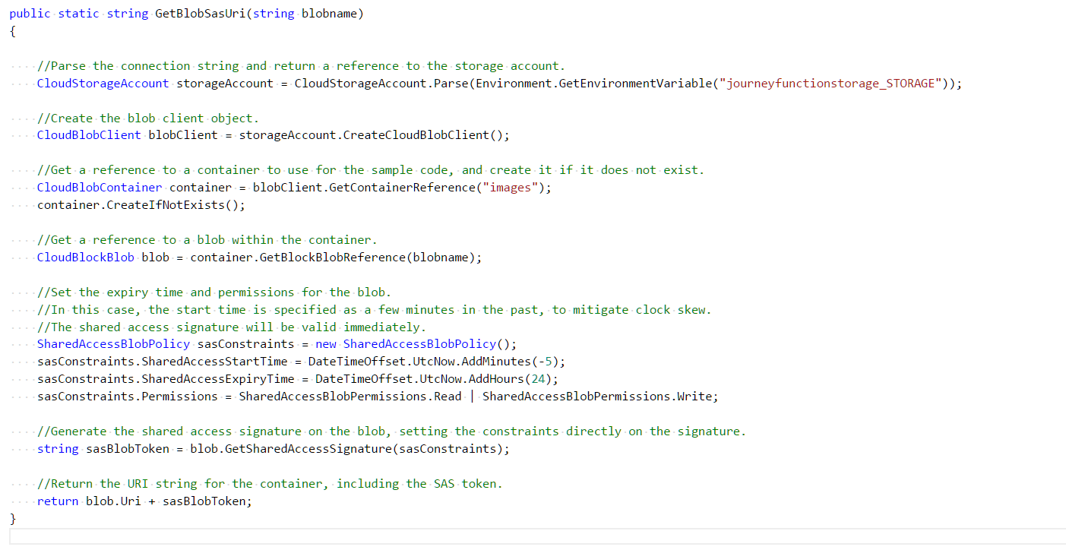
The Pico-Service
#1
C# Code
(Pt 2)
Notes:
On line 41 change the storage connection
#r "Microsoft.WindowsAzure.Storage"
using System.Net;
using Microsoft.WindowsAzure.Storage;
using Microsoft.WindowsAzure.Storage.Blob;
using Microsoft.WindowsAzure.Storage.Queue;
public static async Task<HttpResponseMessage> Run(HttpRequestMessage req, ICollector<ImageDTO> outQ, TraceWriter log)
{
// Read the content of the request
string WebInputURI = await req.Content.ReadAsAsync<string>();
// throw an error if inputuri is null
if (WebInputURI == null)
{
return req.CreateResponse(HttpStatusCode.BadRequest, "Please pass a URI in the json request body");
}
// Create the output object to pop on the queue and populate it, the ICollector binding should wire up the actual queue write for us.
ImageDTO myq = new ImageDTO()
{
OutputSAS = GetBlobSasUri(Guid.NewGuid().ToString()),
InputURI = WebInputURI
};
outQ.Add(myq);
return req.CreateResponse(HttpStatusCode.Accepted, myq.OutputSAS);
}
public class ImageDTO
{
public string InputURI {get; set;}
public string OutputSAS {get; set;}
}
public static string GetBlobSasUri(string blobname)
{
//Parse the connection string and return a reference to the storage account.
CloudStorageAccount storageAccount = CloudStorageAccount.Parse(Environment.GetEnvironmentVariable("journeyfunctionstorage_STORAGE"));
//Create the blob client object.
CloudBlobClient blobClient = storageAccount.CreateCloudBlobClient();
//Get a reference to a container to use for the sample code, and create it if it does not exist.
CloudBlobContainer container = blobClient.GetContainerReference("images");
container.CreateIfNotExists();
//Get a reference to a blob within the container.
CloudBlockBlob blob = container.GetBlockBlobReference(blobname);
//Set the expiry time and permissions for the blob.
//In this case, the start time is specified as a few minutes in the past, to mitigate clock skew.
//The shared access signature will be valid immediately.
SharedAccessBlobPolicy sasConstraints = new SharedAccessBlobPolicy();
sasConstraints.SharedAccessStartTime = DateTimeOffset.UtcNow.AddMinutes(-5);
sasConstraints.SharedAccessExpiryTime = DateTimeOffset.UtcNow.AddHours(24);
sasConstraints.Permissions = SharedAccessBlobPermissions.Read | SharedAccessBlobPermissions.Write;
//Generate the shared access signature on the blob, setting the constraints directly on the signature.
string sasBlobToken = blob.GetSharedAccessSignature(sasConstraints);
//Return the URI string for the container, including the SAS token.
return blob.Uri + sasBlobToken;
}

Slide 36
So, lets show this part working @ https://aka.ms/aidemo
https://aka.ms/aiapp
https://aka.ms/blobapp
https://github.com/dxuk/ukofficehours
Notes:
Diego Costa http://img-s-msn-com.akamaized.net/tenant/amp/entityid/BBD0Lyr.img?h=764&w=1019&m=6&q=60&o=f&l=f&x=565&y=222
ME! https://media.licdn.com/mpr/mpr/shrinknp_200_200/AAEAAQAAAAAAAAjnAAAAJDg5YjBmNmYzLWJlNmUtNDdhOS1hZTFiLTU1YzNiNjJlYmRmZg.jpg
Show the code working and running
See that we are not yet getting a response as Gabriel hasn’t yet done his component to connect to the AI Service.

Slide 37
Thanks for listening.
If you would like further training / advice and you build or architect software / services in the cloud professionally, you can sign up for our free events program by emailing vipazure@microsoft.com

